Slide 1
LGBT Economic Equality:
Are We There Yet?
M. V. Lee Badgett
Univ of Massachusetts Amherst
July 12, 2022

Slide 2
Progress on rights…
Plus side:
  Marriage equality
  Protections against employment discrimination
Negative side:
  Still can’t pass Equality Act
  Attacks on trans youth
  Supreme Court threat on criminalization and marriage equality

Slide 3
But lived experience? No, we are not there!
Worse economic outcomes
Disadvantages vary within LGBT community
Driven by discrimination
How exclusion also hurts our economy
Need for more data

Slide 4
Wage gaps for LGB people (holding all else equal)
Gay/bi men
  Klawitter (2015): 11% less
  Drydakis (2022): 7% less for gay men, 10% less for bi men
Why negative?
  Discrimination (bigger gap where most negative attitudes; smaller gap where laws)
Lesbian/bisexual women
  Klawitter: 9% higher earnings
  Drydakis: 7% higher for Ls, 10% lower for B women
  BUT: All women earn less than GBH men
Why?
  More observable experience
  More unobservable experience?

Slide 5
Wage gaps for LGB people (holding all else equal)
Gay/bi men
  Klawitter (2015): 11% less
  Drydakis (2022): 7% less for gay men, 10% less for
Why?
  Discrimination (bigger gap where most negative attitudes; smaller gap where laws)
Lesbian/bisexual women
  Klawitter: 9% higher earnings
  Drydakis: 7% higher for Ls, 10% lower for B women
  BUT: All women earn less than GBH men
Why positive?
  More observable experience
  More unobservable experience?

Slide 6
Wage & income gaps: Transgender people
Moving from pre-transition to post-transition (US, Netherlands):
  Trans women’s earnings fall
  Trans men’s earnings don’t change much
  Transgender effect + or – gender effect
Household income lower for trans people in US
  BRFSS: FTM have larger income gap than MTF; no gap for gender nonconforming (Carpenter et al 2020)
  Household Pulse: lower for trans women and for those not identifying with gender binary labels (relative to ciswomen) (Carpenter et al, 2022)
Earnings 14%-18% lower for trans people comparing USTS to ACS (Shannon 2021)

Slide 7
Are things getting better?

Slide 8
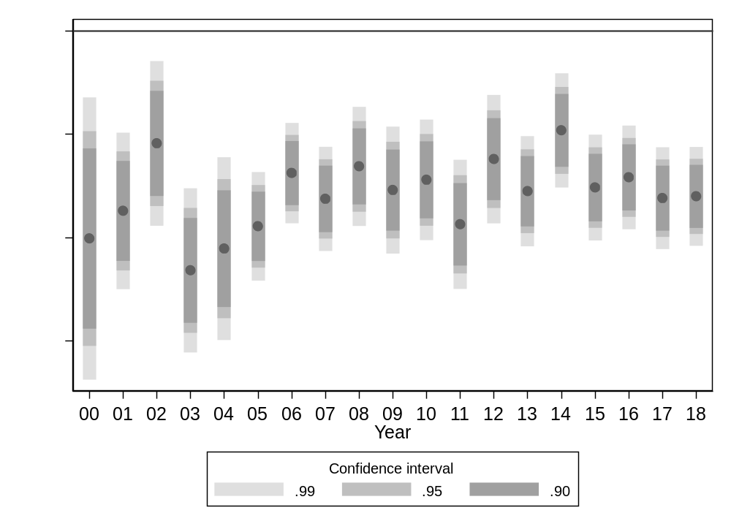
Panel B: Men. With demographic controls and state fixed-effects.
Persistent
negative gap
Badgett, Carpenter, Sansone 2020

Slide 9
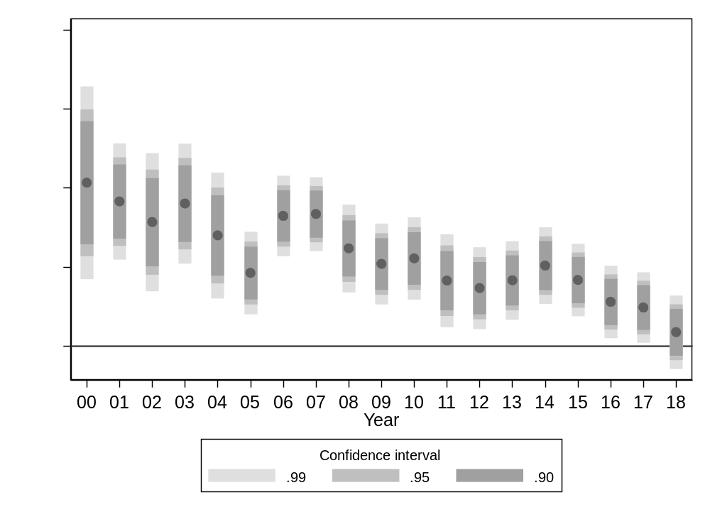
Panel A: Women. With demographic controls and state fixed-effects.
Positive diff
disappearing
Badgett, Carpenter, Sansone 2020

Slide 10
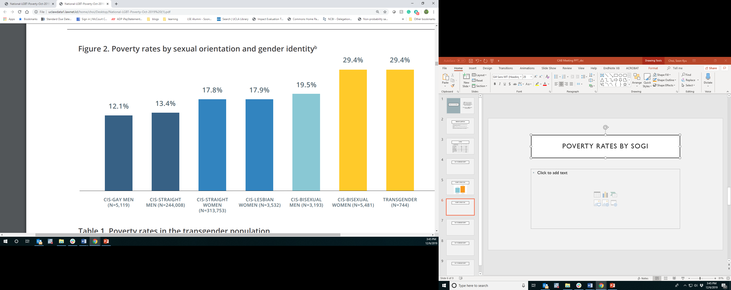
Poverty rates by SOGI (BRFSS; Badgett et al 2019)
Trans men
33.7%
Trans women
29.6%
GNC
23.8%
Notes:
Transgender people
%
95% CI
n
Trans men
33.7
(26.8, 41.4)
172
Trans women
29.6
(24.1, 35.7)
242
Gender nonconforming
23.8
(17.7, 31.3)
109
Transgender men : 34% (n=172)
Transgender women : 30% (n=242)
Gender nonconforming: 24% (n=109)

Slide 11
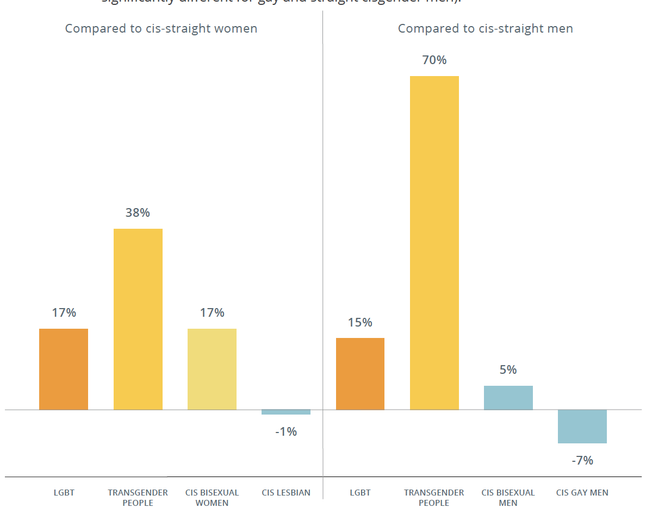
All else equal…
Notes:
Higher odds of being poor controlling for educ, age, children, race, language, rural/urban, disability, partnership status, health, employment status

Slide 12
A word on COVID: worse
Higher level of financial problems (paying rent, affording basics)
Higher levels of food insecurity: 13% LGBT vs 7% nonLGBT
More layoffs, loss of hours, lost income
Delayed medical care
Safety issues at work
https://www.census.gov/library/stories/2021/08/lgbt-community-harder-hit-by-economic-impact-of-pandemic.html

Slide 13
Effects of intersectionality in wages & poverty
Gender: assigned female at birth have worse measures
Race & ethnicity:
  white LGBT people better off than LGBT people of color
  Cis-het people of color better off than LGBT people of color

Slide 14
Does discrimination explain wage gaps and higher poverty rates? Likely contributor

Slide 15
Self-reported discrimination
30% of LGBT employees report being fired or not hired bc of SOGI (in lifetime)
  49% of transgender employees
  28% of cisgender LGB employees
  29% of LGBT persons of color, 18% of white LGBTs
40% experienced discrim or harassment
57% of discrim/harassment motivated by religious beliefs
50% not out to supervisor, 26% not out to any coworkers
https://williamsinstitute.law.ucla.edu/wp-content/uploads/Workplace-Discrimination-Sep-2021.pdf
Notes:
But don’t know if too high, or not high enough.

Slide 16
Experiments in hiring process show discrim
18 + studies in OECD countries
Flage (2020): 35% lower odds of getting called for an interview for LGB-coded applicants
Studies of transgender people in NYC, Sweden, Malaysia, Singapore, Thailand, and Vietnam show lower odds for transgender workers, too
Include on resume:
  Gender identity: changes in names, pronouns
  Sexual orientation: relevant job experience in LGB organization at University; same-sex partner; explicit identity on social media

Slide 17
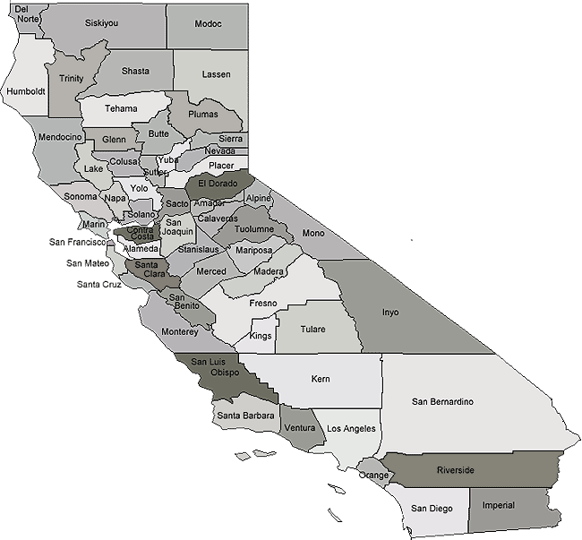
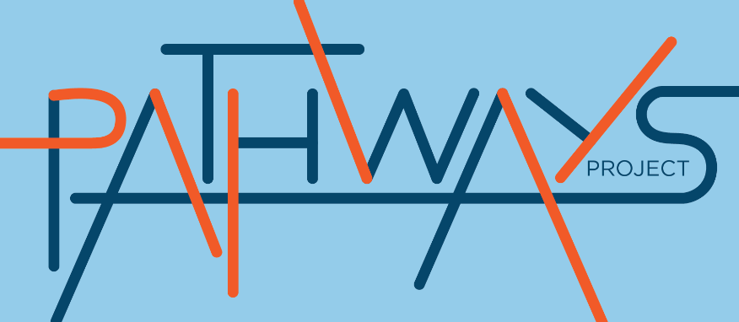
Role of discrimination in higher rates of poverty
93 LGBTQ people living in poverty
  Los Angeles Co n=60
  Kern Co n=33
  Wilson et al, 2020
Notes:
reported having ever or recently struggled , 1/19 thru 5/20
Coded in multiple stages—inductively, looked at what saying about jobs. Quotes illustrate tyupes of responses

Slide 18
Pathways out of poverty:
Intergenerational poverty especially important for LGBT people of color, so pathway out is harder
Barriers to getting and keeping jobs: health, discrimination; linked to disclosure of SOGI status
Opportunities for low quality jobs: Low wage, less stable
Resources for getting jobs are limited

Slide 19
Human capital & economic potential
Education
Employment
Health
Businesses
LGBTI INCLUSION
ECONOMIC
OUTPUT FOR COUNTRIES
Notes:
Biz cares about educ/emp/health—that’s who you’ll hire and sell to

Slide 20
Latest Business Case Research
More LGBT-positive policies lead to:
Higher stock prices
Higher profits
Higher productivity
Attracting more creative workforce

Slide 21
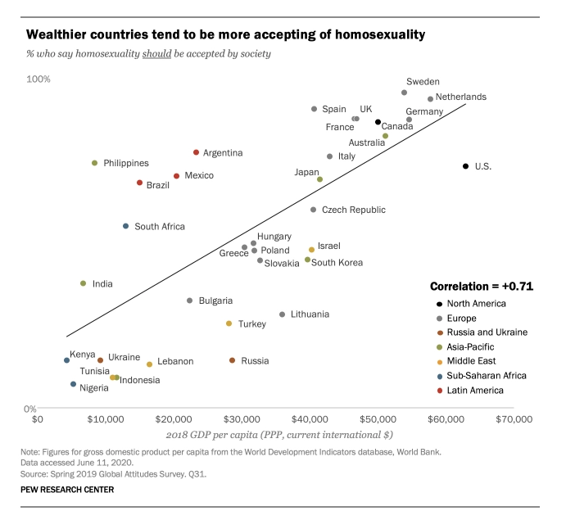

Slide 22
Econometric findings
Emerging Economies
One additional right
+ $320 GDP per cap (3%)
Notes:
They are linked, not just correlated. In a way that is important to understand for national economies, businesses, and LGBT people.
Why, and why does it matter?

Slide 23
Econometric findings
133 countries
One additional right
+ $2065 GDP per cap
Notes:
They are linked, not just correlated. In a way that is important to understand for national economies, businesses, and LGBT people.
Why, and why does it matter?

Slide 24

The power of making an Economic Case
Complements human rights arguments—we need both
Opens doors
  Business & Financial sector
  Development banks & agencies
Actions
  Push for inclusive laws & policies
  Direct efforts in economic empowerment
  Better data to measure & monitor progress

Slide 25
A final word: Data
Big samples to look at intersectionality
More SOGI questions
Questions about intersex status
Workplace questions
  Employer-level data: representation in hiring, promotions

Slide 26
